Slide 1
MyGeoHub Geospatial Gateway
Rajesh Kalyanam
Purdue University

Slide 2
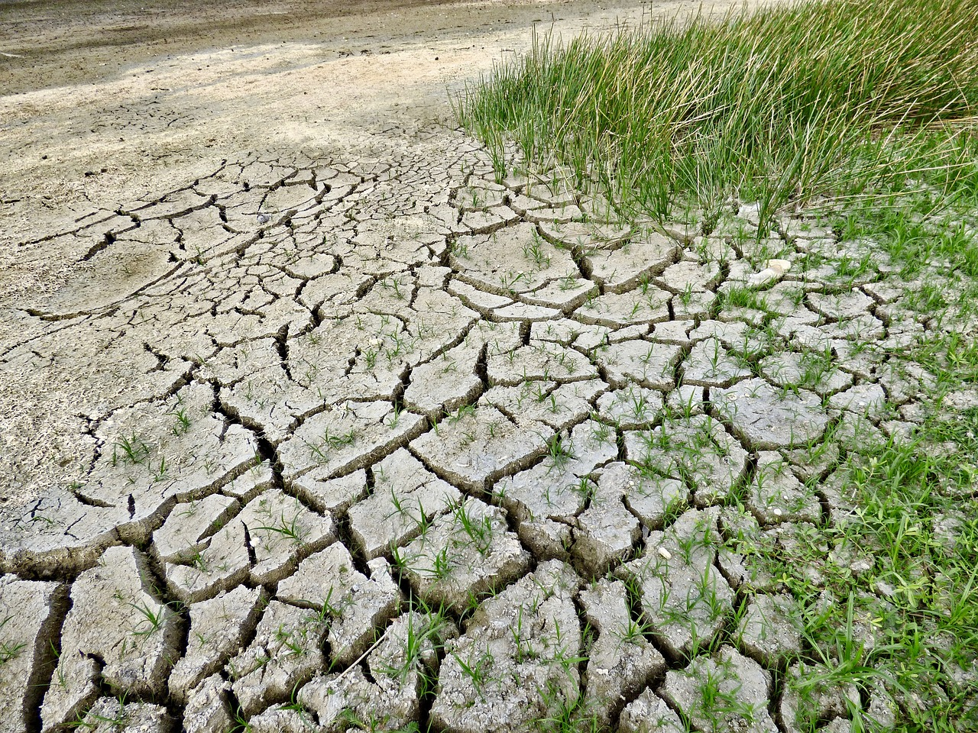
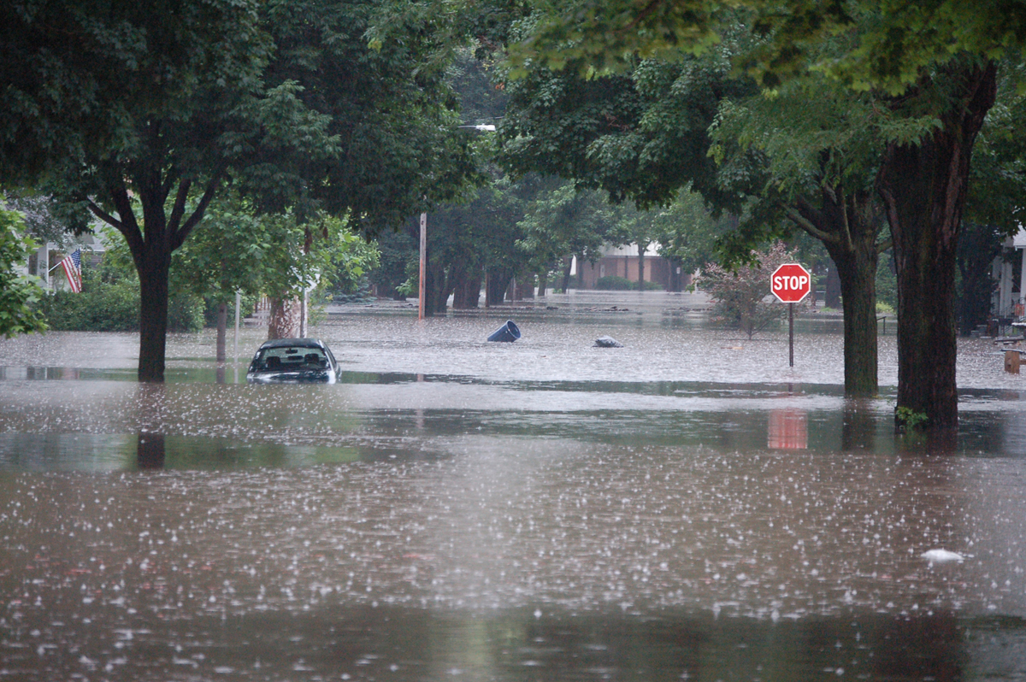
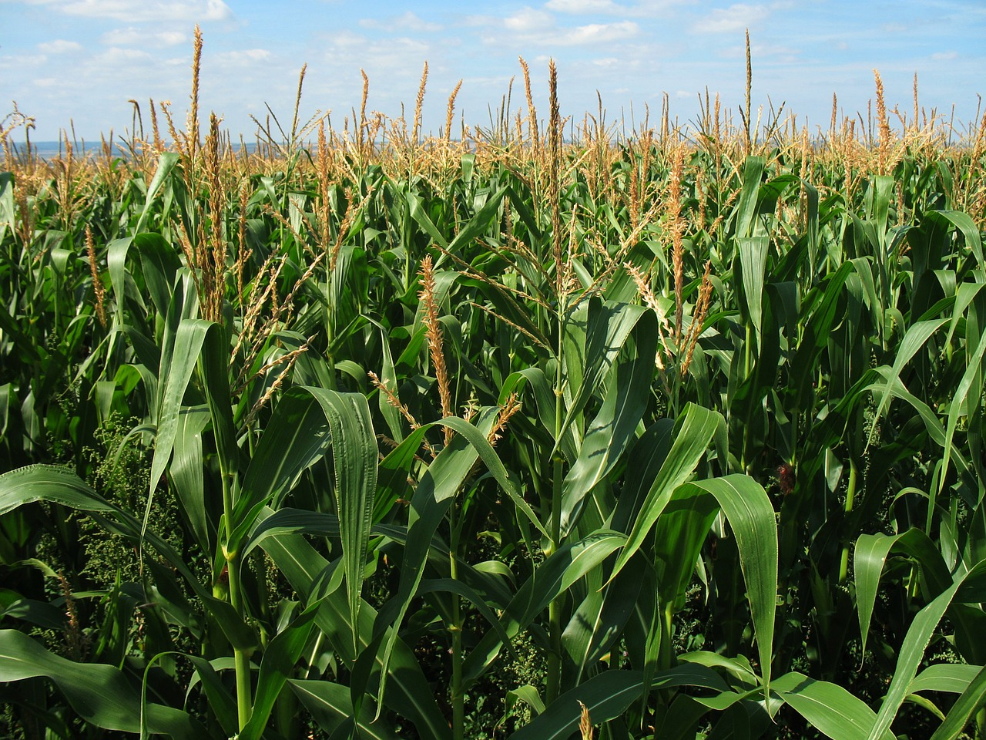
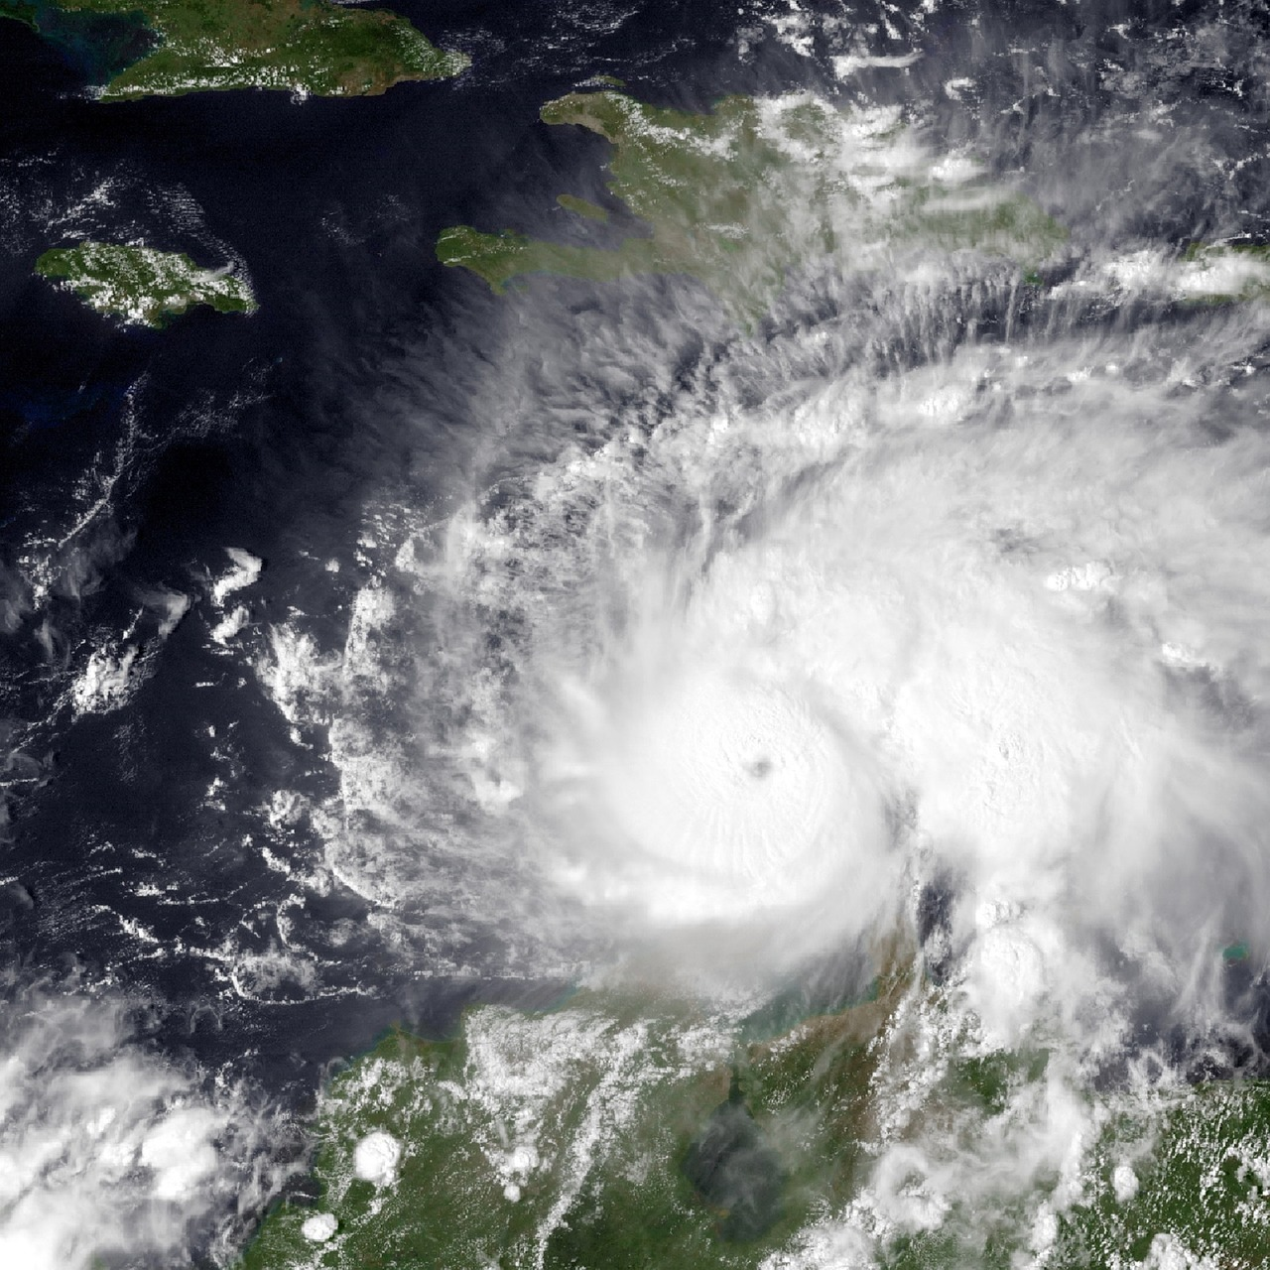
Geospatial Data is Everywhere
Floods
Manage, share, process, publish geospatial data
Drought
Geospatial data is essentially any data that has a location
Agriculture
Weather

Slide 3
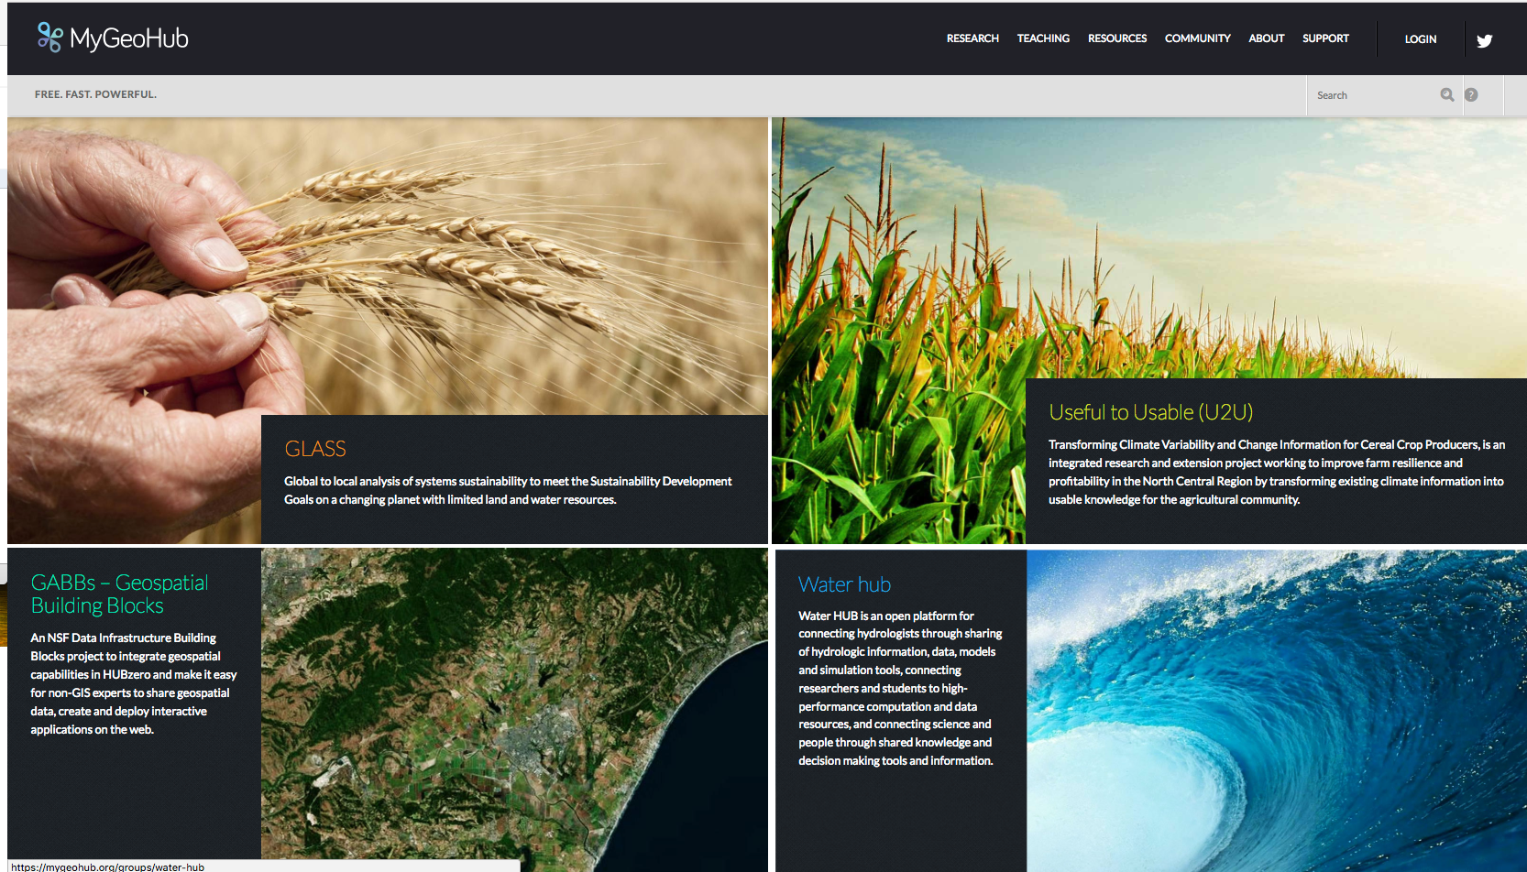
MyGeoHub Geospatial Gateway
Shared hosting of different projects
Containerized tools
Access to HPC (Campus, XSEDE)
Geospatial data management
Data publication with DOIs
Tool development libraries
Interactive Computing (Jupyter, R Studio)

Slide 4
Geospatial Data Management
Geospatial data is highly structured
Standard libraries to interpret it
Often includes metadata describing file contents
MyGeoHub geospatial data management
Automatic metadata extraction on upload
Support for geospatial data preview
Keyword search for files based on extracted metadata, location

Slide 5
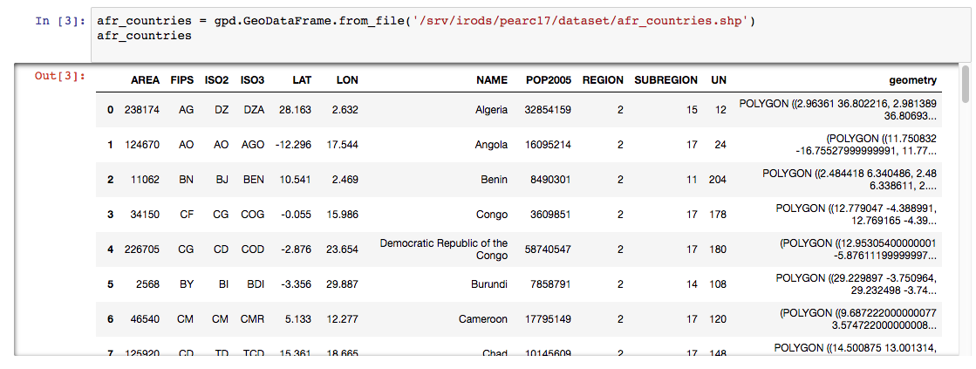
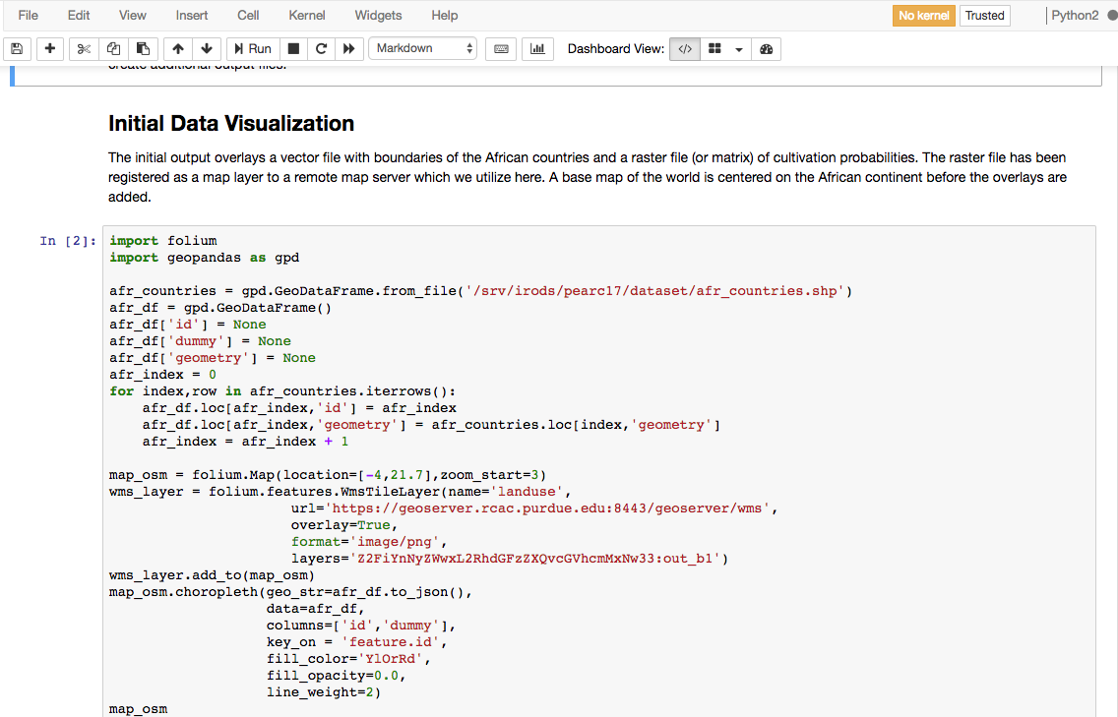
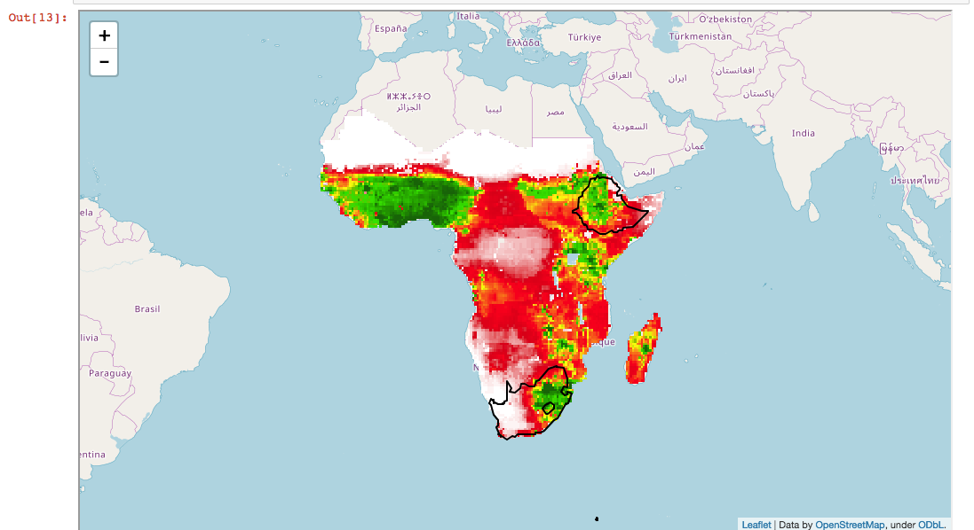
Interactive Computing – Jupyter Notebooks
Data exploration
Inline code, descriptive text
Geospatial data visualization

Slide 6
TASK 1: Augment Metadata Using External Service
Obtain authorization
Submit file to BrownDog for extraction
Poll for status
Process returned metadata for GPS info
Display image locations on map
NCSA’s BrownDog provides a service for processing files, extracting metadata
MyGeoHub does not handle image files with embedded GPS info
By extracting GPS info, can display image locations on map, aid search
Crop images can indicate plant health, location provides region to focus on
Software requirements: Python Requests (for HTTP GET/POST interaction with BrownDog, JSON (process returned metadata), ipyleaflet (mapping library), ipywidgets (interactive UI)

Slide 7
TASK 2: Gather Active Social Media Content During Weather Event
Select weather event of interest from map
Access public Twitter stream, filter by weather keywords
Filter to region of interest (based on tweeting location, if any)
Measure relevance to weather event; display filtered tweets
Social media analysis increasingly popular
Novel combination involves weather data and social media content
Find tweets relevant to weather event
Region of interest, topic
Predict user actions, sentiments during extreme weather; help influence against risky behavior, direct resources
Software requirements: Python Requests (for HTTP GET/POST interaction with NWS), XML (process NWS data), tweepy (Twitter library), ipyleaflet (mapping library), ipywidgets (interactive UI)

Slide 8
Questions?
rkalyana@purdue.edu
https://mygeohub.org

